Slide 1
CSC1004 Tutorial 1
Runyi Zhao

Slide 2

IntelliJ IDEA
Website: https://www.jetbrains.com/idea/.
Click here to download.

Slide 3
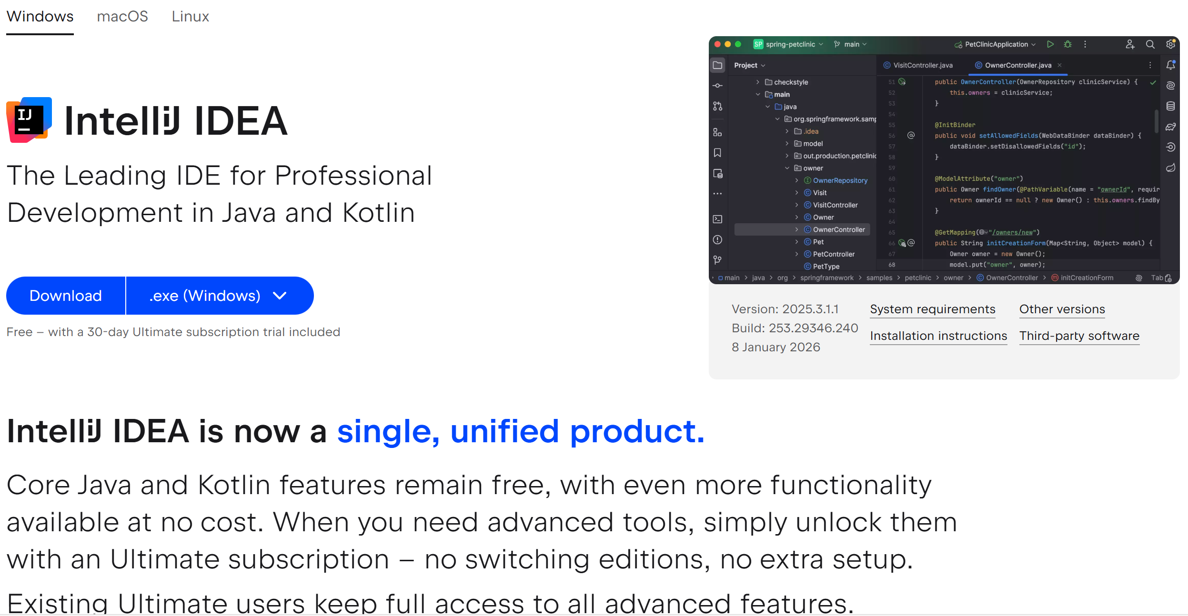
IntelliJ IDEA
Click here to select your operating system.
Click here to download.
No more ultimate edition, and ultimate edition features are not in need in most cases

Slide 4
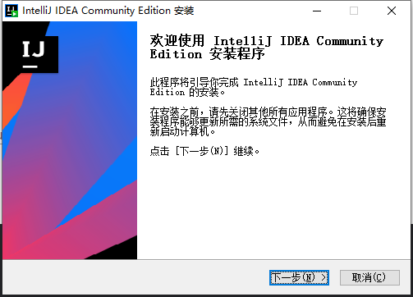
IntelliJ IDEA
My OS is Windows.
Follow the guidelines to install IntelliJ IDEA.

Slide 5
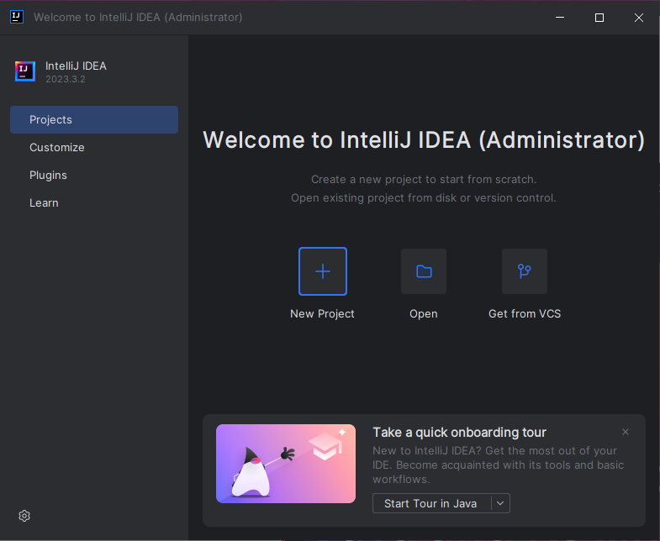
Java Project
Create a new project by clicking here.

Slide 6
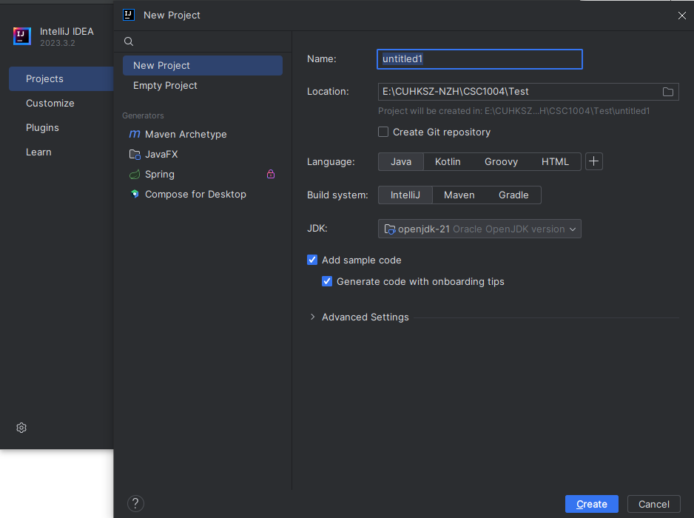
Java Project
Note that you might need to download the JDK.
IntelliJ IDEA provides an automatic way to get the JDK.

Slide 7
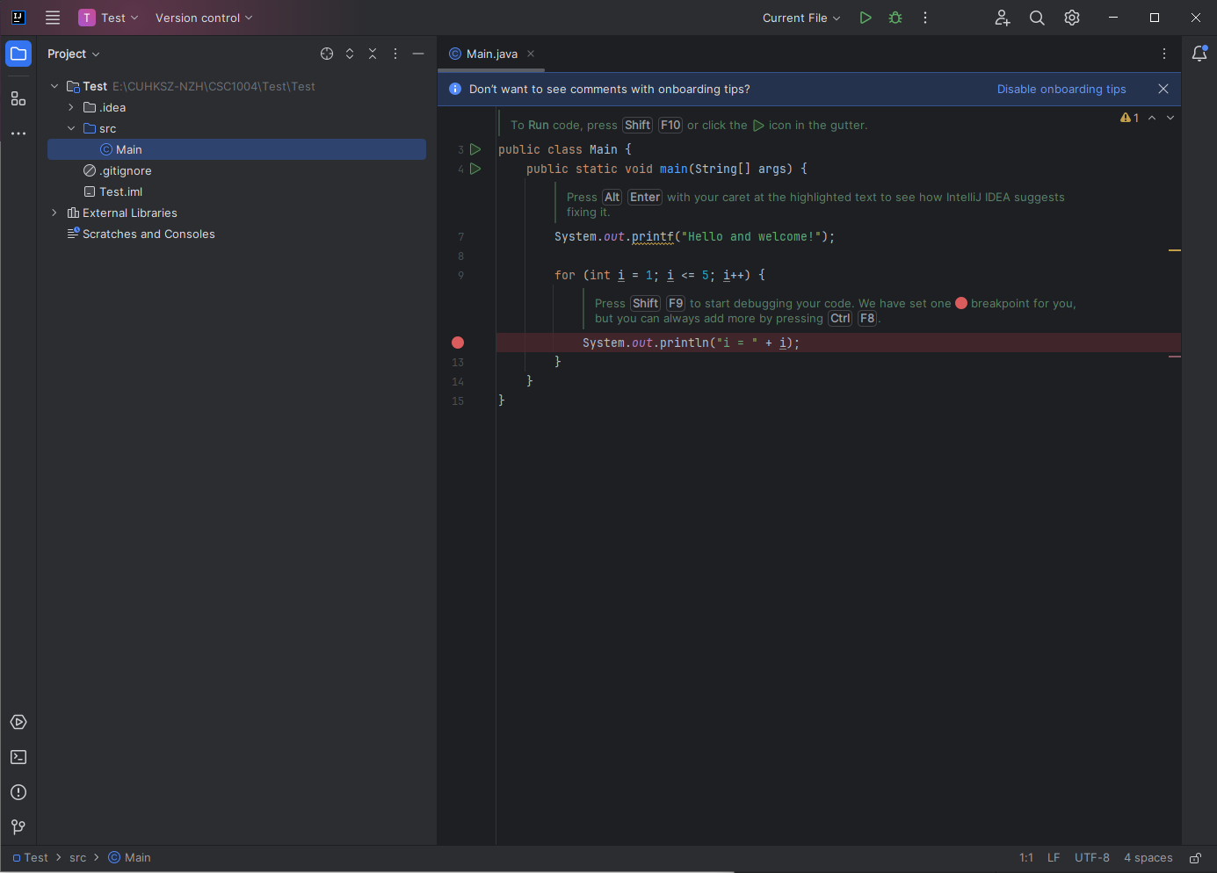
Java Project
The IntelliJ IDEA interface is shown once you have created the project.
Click here to run your Java project.

Slide 8
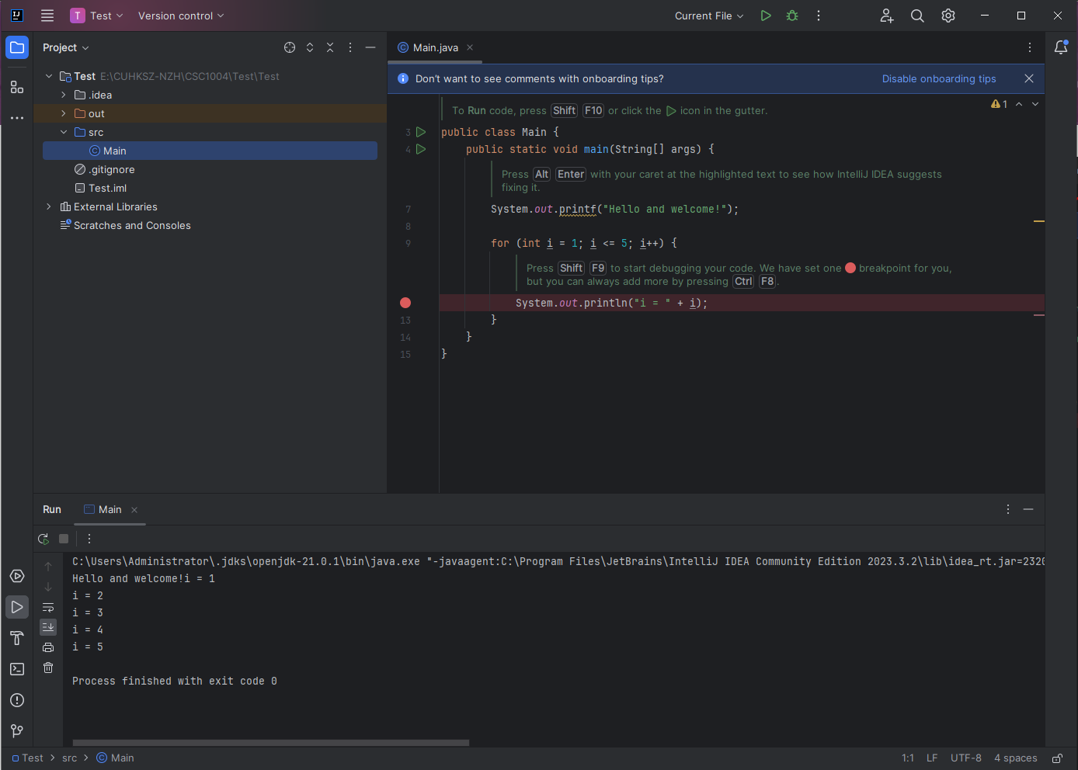
Java Project
The results can be seen here.

Slide 9
Java Project
Click here to debug your Java project.
This red point is the breakpoint of your code.

Slide 10
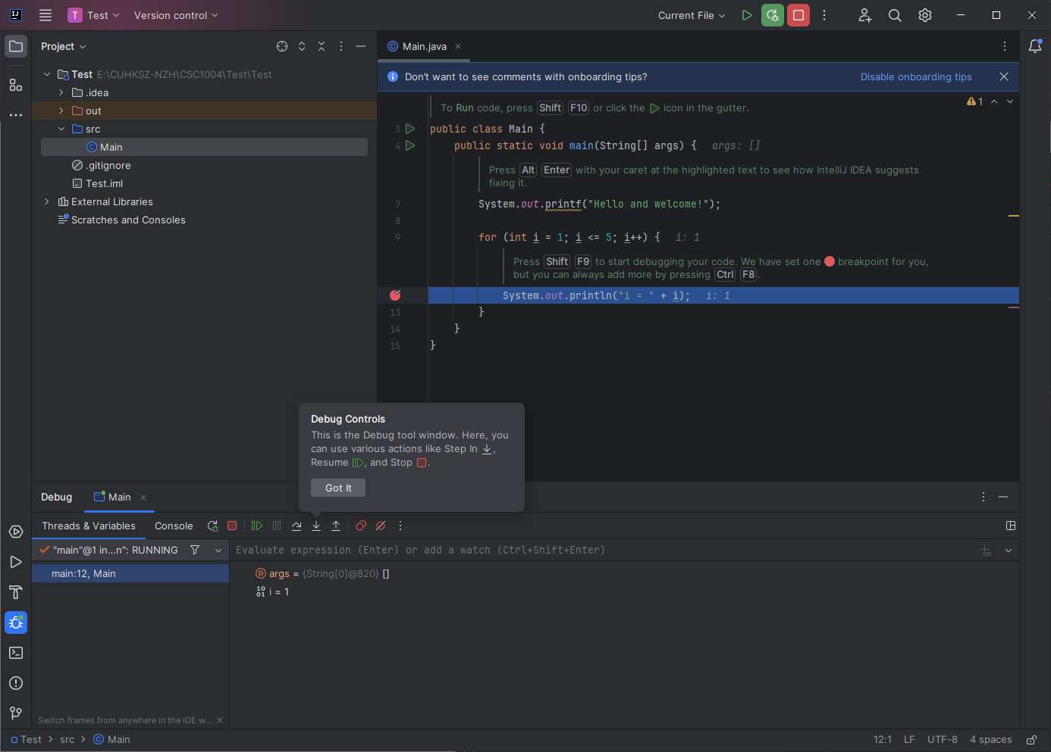
Java Project
After you click here to debug your Java project …
Your code is suspended at the breakpoint.
You may view the values of your variables.

Slide 11
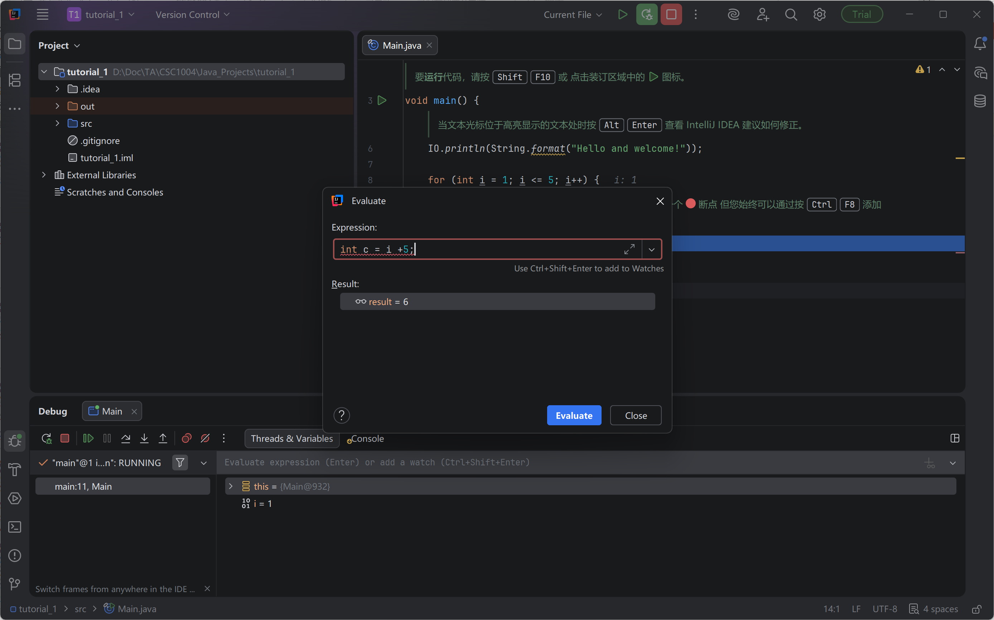
Java Project
Use Alt+F8 in “Variables & Threads”to type your debugging code
Local & global variables accessable
Can serve as a debug console.

Slide 12
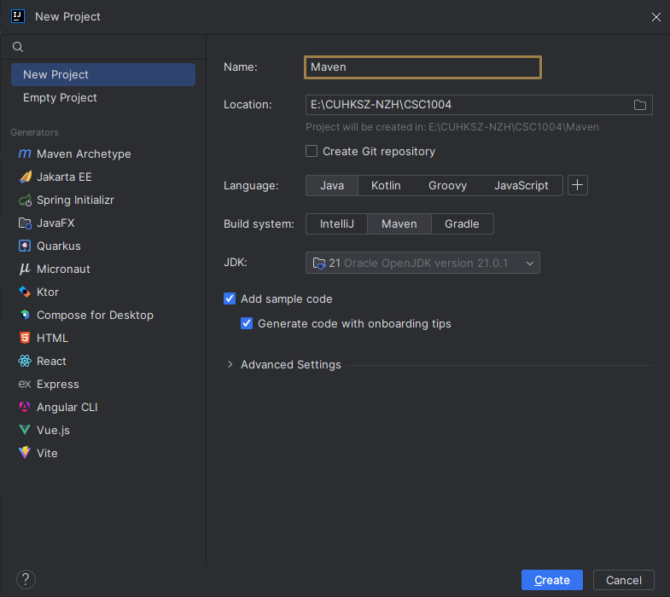
Java Maven Project
Maven is a tool for building and managing any Java-based project. It can make the day-to-day work of Java developers easier and generally help with the comprehension of any Java-based project.
You can easily use Maven in IntelliJ IDEA.

Slide 13
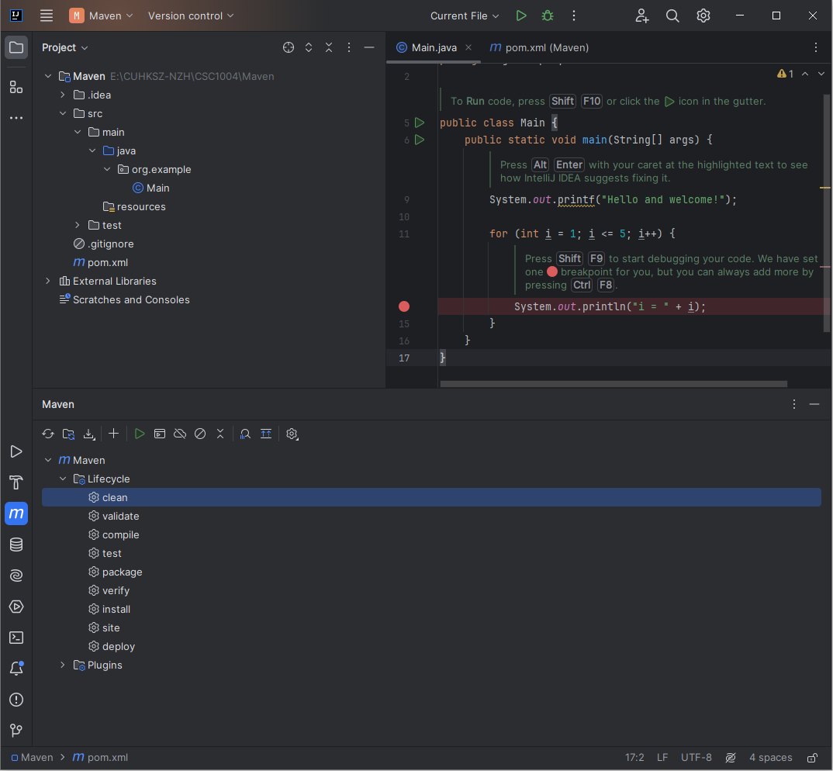
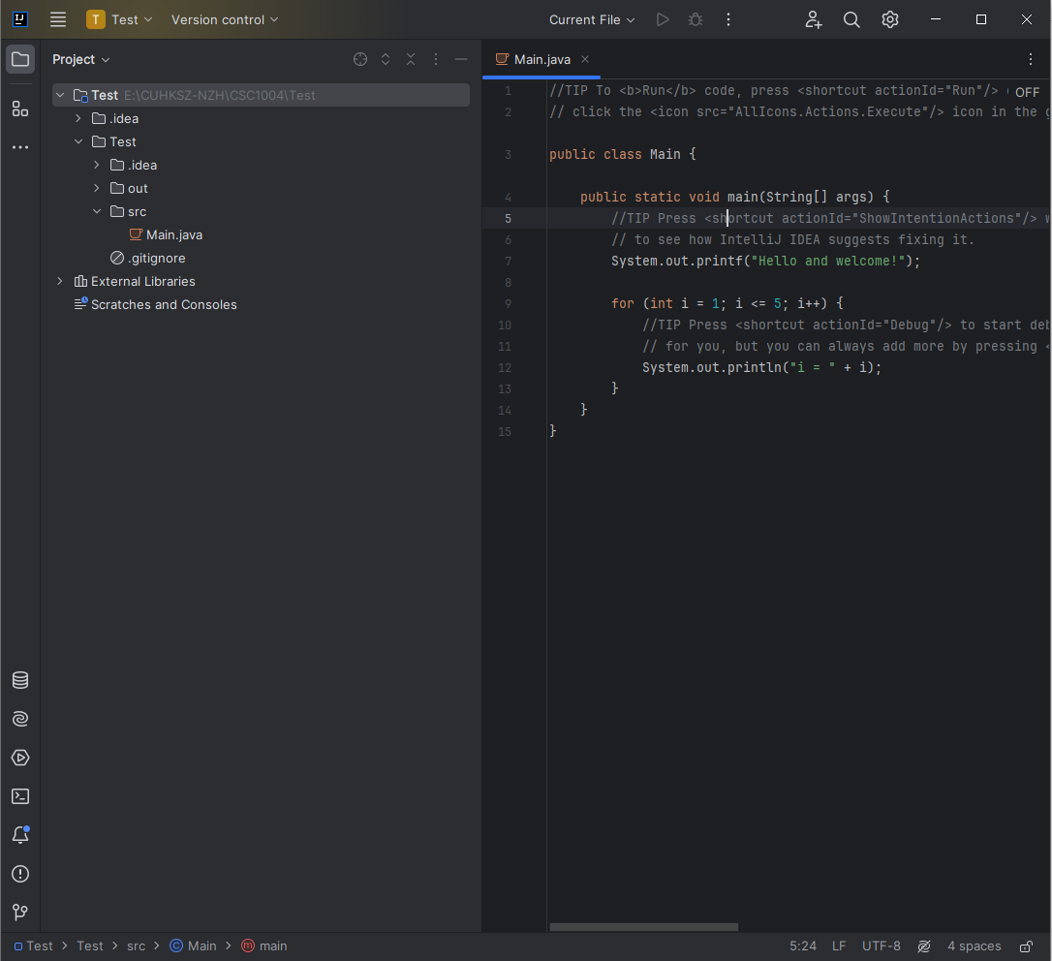
Java Maven Project
Java Project with Maven
Java Project without Maven
Maven provides many lifecycle phases that facilitates Java projects.

Slide 14
Java Maven Lifecycle Phases
clean:
  Remove all files generated by the previous build.
validate:
  Validate the project is correct and all necessary information is available.
compile:
  Compile the source code of the project..
test:
  Run tests using a suitable unit testing framework. These tests should not require the code be packaged or deployed.
package:
  Take the compiled code and package it in its distributable format, such as a JAR..

Slide 15
Java Maven Lifecycle Phases
verify:
  Run any checks to verify the package is valid and meets quality criteria..
install:
  Install the package into the local repository, for use as a dependency in other projects locally.
site:
  Generate the project's site documentation.
deploy:
  Done in an integration or release environment, copies the final package to the remote repository for sharing with other developers and projects..

Slide 16
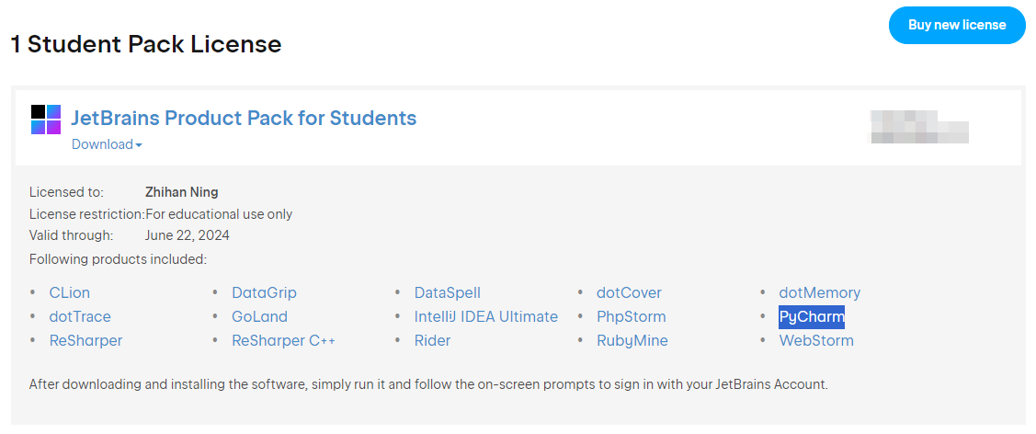
Java Maven Lifecycle Phases
You can get a license using your CUHKSZ email:
  https://account.jetbrains.com/licenses.
  It provides ultimate version of IntelliJ IDEA, Professional PyCharm, etc.

Slide 17
Life Cycles of Threads in Java
In Java programming, threads enable concurrent execution and multitasking within an application. Understanding the life cycle of threads in Java and the various states is essential for efficient and synchronized thread management.
The life cycle of Thread in Java refers to the various stages a thread goes through during its execution. A thread can exist in different states throughout its life cycle, each with specific characteristics and behaviors. In this article, we will explore the thread life cycle in Java and its states in Java.
The term Threads in Java is a lightweight process that allows multiple tasks to be executed simultaneously within a single program. It enables the application to perform two or more actions concurrently, thus improving the system's performance. Threads can exist in various states like ready, running, waiting and dead during their lifecycle, and each state has different characteristics. They are also known as lightweight processes because they share common memory and resources with other threads within the process. Threads are an essential part of the Java programming language as they can be used to achieve parallelism and improve performance and responsiveness. In short, Threads are a vital part of multithreaded programming in Java.

Slide 18
Importance of Life Cycles
Understanding the life cycle of a thread in Java and the states of a thread is essential because it helps identify potential issues that can arise when creating or manipulating threads.
It allows developers to utilize resources more effectively and prevent errors related to multiple threads accessing shared data simultaneously.
Knowing the thread states in Java helps predict a program's behavior and debug any issues that may arise.
It also guides the developer on properly suspending, resuming, and stopping a thread as required for a specific task.

Slide 19
Various States of a Life Cycle
New (born) state
  Example: Creating a new thread using the Thread class constructor.
  Use case: Creating a new thread to perform a background task while the main Thread continues with other operations.
Runnable state
  Example: After calling the start() method on a thread, it enters the runnable state.
  Use case: Multiple threads competing for CPU time to perform their tasks concurrently.
Running state
  Example: When a thread executes its code inside the run() method.
  Use case: A thread executing a complex computation or performing a time-consuming task.
Blocked state:
  Example: When a thread tries to access a synchronized block or method, but another thread already holds the lock.
  Use case: Multiple threads accessing a shared resource can only be obtained by a single Thread, such as a database or a file.

Slide 20
Various States of a Life Cycle
Waiting state:
  Example: Using the wait method inside a synchronized block, a thread can wait until another thread calls the notify() or notifyAll() methods to wake it up.
  Use case: Implementing the producer-consumer pattern, where a thread waits for a specific condition to be met before continuing its execution
Timed waiting state:
  Example: Using methods like sleep(milliseconds) or join(milliseconds) causes a thread to enter the timed waiting state for the specified duration.
  Use case: Adding delays between consecutive actions or waiting for the completion of other threads before proceeding.
Terminated state:
  Example: When the run() method finishes its execution or when the stop() method is called on the Thread.
  Use case: Completing a task or explicitly stopping a thread's execution.
  Understanding the different thread states helps in designing efficient and responsive multithreaded applications.

Slide 21

THANK YOU
林天麟 教授
香港中文大学（深圳）
机器人与人工智能实验室
WeChat: tinlunlam

